Slide 1
608

Slide 2

University of the Philippines Cebu
Phil-LiDAR 2
Using Object Based Image Analysis in Extracting Nearshore Aquaculture Features
in Victorias City, Negros Occidental
Mark Anthony A. Cabanlit
Presentor
Judith R. Silapan², Ariadne Victoria S. Pada¹, Florencio P. Campomanes V¹, Julius Jason S. Garcia¹
¹University of the Philippines Cebu Phil-LiDAR 2, Cebu City, Cebu, Philippines,
²University of the Philippines Cebu, Cebu City, Cebu, Philippines,
Notes:
Good Morning once again!
I’ll be presenting a study about ‘Using Object Based Image Analysis in Extracting Nearshore Aquaculture Features
in Victorias City, Negros Occidental’. This is basically the in depth feature extraction of the study I presented about 15 minutes ago.

Slide 3
Aquaculture Production
In the Philippines
Country’s Fish Produce
In 2013 alone, the Philippine Fishing Industry has produced 4,705,413.29 metric tons of fish products; and 2,373,386.48 or about 50.44% of it is from Aquaculture
Coastal Area
The Philippines has 266,000 square kilometers of coastal territorial area where nearshore aquaculture features such as Fish Corrals are located.
2
Notes:
In 2013 alone, the Philippine Fishing Industry has produced 4,705,413.29 metric tons of fish products; and 2,373,386.48 or about 50.44% of it is from Aquaculture.
Our country has 266,000 square kilometers of coastal territorial area where nearshore aquaculture features such as Fish Corrals are located.

Slide 4
Objective
Fish Corral Extraction
To extract Fish Corral features in the City of Victorias with high accuracy.
3
Notes:
The main objective of the study is to extract Fish Corral features in the City of Victorias with a high accuracy.

Slide 5
Fish Corral
A Very Predominant Method of Catching Fish
Description
It is one popular method of catching fish along tidal flats, in coral reefs and mangrove areas. They are located in bays or near estuaries with moderate currents (not strong waves), affected by tidal fluctuations. This fishing gear is stationary and is constructed in areas known to be rich fishing grounds.
2
3
Parts
1
Leader
3
Bunt
Also called the guiding barrier, it is made of bamboo slats with nylon nets connected to a 3.0 cm wooden post.
The bunt is where the fish are trapped. It is usually heart-shaped with a small opening
2
Playground
4
Nylon Net
A semi-round shape made of the same materials as the leader.
It is fine-meshed with sizes of 1.27-1.9 cm opening.
1
4
Notes:
What is a fish corral? I’ve been talking about this for a while now but I haven’t clearly discussed it yet. I’m so sorry for that.
It is one popular method of catching fish along tidal flats, in coral reefs and mangrove areas. They are located in bays or near estuaries with moderate currents (not strong waves), affected by tidal fluctuations. This fishing gear is stationary and is constructed in areas known to be rich fishing grounds.
The fish corral consists of a guiding barrier or leader made of bamboo slats with nylon nets connected to a 3.0 cm wooden post. The size of the corral varies from 30.0-100.0 m wide. It is shaped like an arrow tip, pointed towards the sea from shoreline. At the back of the leader is the playground, a semi-round shape made of the same materials as the leader. Connected to the playground is the terminal pound or bunt where the fish are trapped. The bunt is usually heart-shaped with a small opening. The nylon net of the leader and playground is fine-meshed with sizes of 1.27-1.9 cm opening.

Slide 6
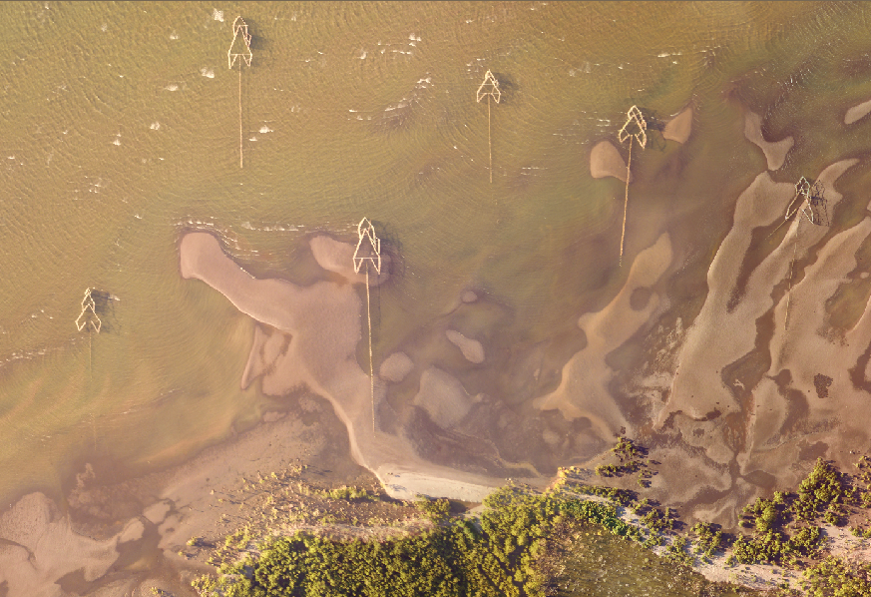
SAMPLE
Notes:
How does it work?
Normally, the movements of fish are guided by tidal currents. At high tide, they travel towards the shore to forage and look for food. During low tide, they follow the current drifting towards the sea. If they happen to enter the fish corral contraption, they are finally trapped

Slide 7
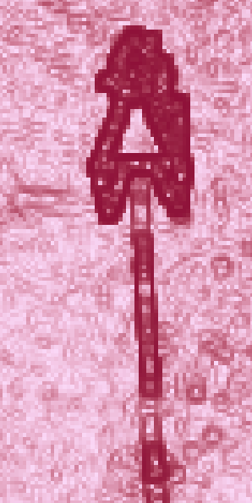
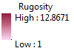

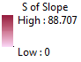


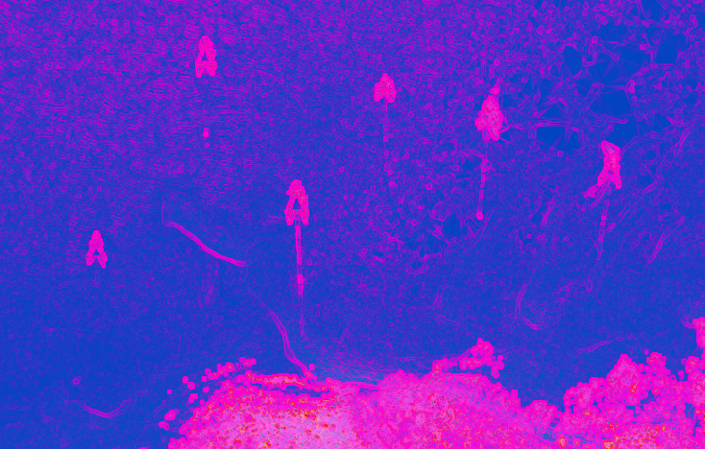
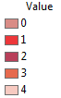
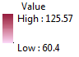
Workflow
The Flowchart below shows the Process of Extracting Fish Corral Features
In ArcMap, we create Slope of Slope and Rugosity.
DSM & NumRet
PCA
LiFAR Data
ArcMAP
Using the LiDAR data, we produce the following Ratsters: Digital Surface Model and Number of Returns.
Using the aforementioned layers, we perform Principal Component Analysis.
Slope of Slope & Rugosity
ArcMAP
6
Notes:
For the workflow,
Using the LiDAR data, we produce the following Rasters: Digital Surface Model and Number of Returns.
Then in ArcMap, we create Slope of Slope and Rugosity.
Using the aforementioned layers, we perform Principal Component Analysis.

Slide 8
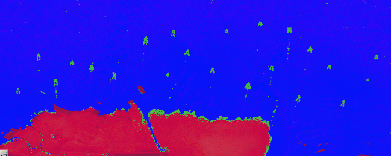
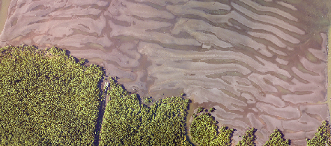
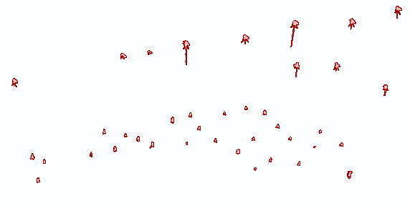
Then we classify the tall structures accordingly.
Land vs. Water
Smoothing
ECog
ArcMap
For the image processing, we separate the Land and water since we only need to process the water.
Tall Structure Classification
Then we smoothen the shapefiles in ArcMap
ECog
7
Notes:
For the image processing, we separate the Land and water since we only need to process the water.
Then we classify the tall structures accordingly if it is either fish corral or otherwise.
Then we smoothen the shapefiles in ArcMap so it looks ok.

Slide 9
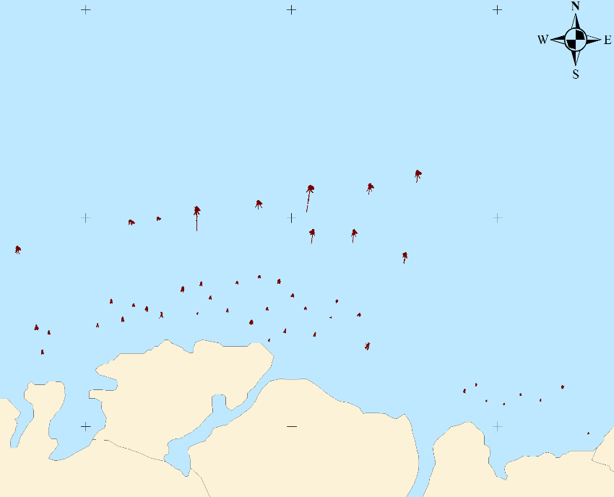
Then we create an ouput map.
Shapefiles
ArcMAP
8
Notes:
Afterwards, we create an output map.

Slide 10
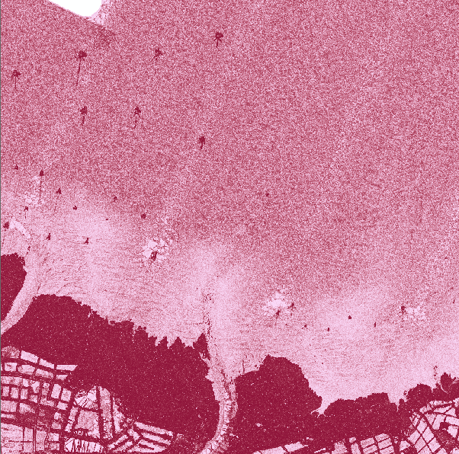

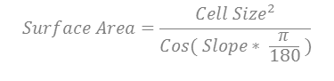
ArcMAP Layers
Derived using Arc
Slope of Slope
Rugosity
Second derivative of bathymetric height. We calculated the slope from the Digital Surface Model then we calculated the slope of the output slope from DSM.
A measure of surface roughness. A ratio of surface area to planar area.
$$Surface Area=\frac{{Cell Size}^{2}}{Cos( Slope∗ \frac{π}{180} )}$$
9
Notes:
The layers derived using Arc, were slope of slope and rugosity.
Slope of slope is the second derivative of bathymetric height. We calculated the slope from the Digital Surface Model then we calculated another slope based from the output slope from DSM.
Rugosity is a measure of surface roughness. It is just a ratio of surface area to planar area. It is equal to the square of the cell size divided by the cosine of slope multiplied by pi over 180.
((1 * 1) / Cos("Slope" * (3.14159265359 / 180))) / (1 * 1)

Slide 11
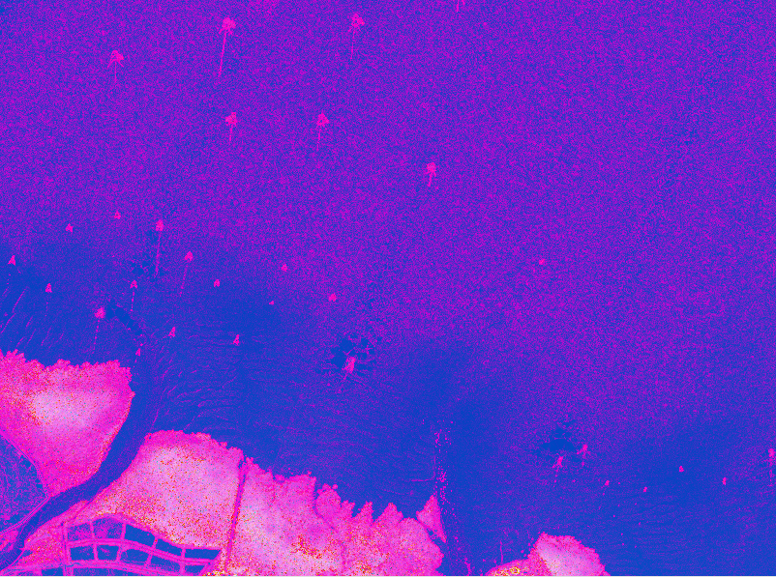
Principal Component Analysis
The Digital Surface Model, Slope of Slope and Rugosity derivatives were used as input for the PCA(Spatial Analyst in ArcMAP.
Notes:
The Digital Surface Model, Slope of Slope and Rugosity derivatives were used as input for the PCA(Spatial Analyst in ArcMAP. The image on the screen is already the PCA.

Slide 12
Image Processing
Using ECognition
1
Segmentation
The image was segmented using Multi-threshold segmentation and multi-resolution segmentation
11
Notes:
The first process of segmentation was using Multi-threshold segmentation.

Slide 13
Image Processing
Using ECognition
1
Segmentation
Muti-threshold
Muti-resolution
The image was segmented using Multi-threshold segmentation and multi-resolution segmentation
Areas with DTM which is:
Scale Parameter = 69, Shape = 0.1
Compactness = 0.5
> 61.6 | Land
<= 61.6 | Water
<0 | No Data
Image Layer | Weight
DSM | 2
NumRet | 1
PCA 1 | 2
PCA 2 | 1
PCA 3 | 1
1
Notes:
Areas with DTM less than or equal 61.6 were classified as water while areas with less than or equal to 0 DTM was classified as No Data. Areas that have DTM which is greater than 61.6 were classified as land. The Water area was further segmented using Multi-resolution segmentation with a scale parameter of 69. Its composition of homogeneity criterion for shape is 0.1 and compactness is 0.5. The image layer weights can be seen in the table on the screen.

Slide 14
Image Processing
Using ECognition
1
2
Segmentation
Classification
The image was segmented using Multi-threshold segmentation and multi-resolution segmentation
The Principal Component Analysis played a great role in the classification of objects.
11
Notes:
The next step is Classification.

Slide 15
Image Processing
Using ECognition
2
Condition
Cleanup
Classification
After merging, all water objects with relative border to tall objects is equal to one was classified as tall also and was merged.
Water with mean first band of PCA which is greater than or equal to 75 were classified as tall.
The Principal Component Analysis played a great role in the classification of objects.
11
Notes:
The Principal Component Analysis played a great role in the classification of objects.

Slide 16
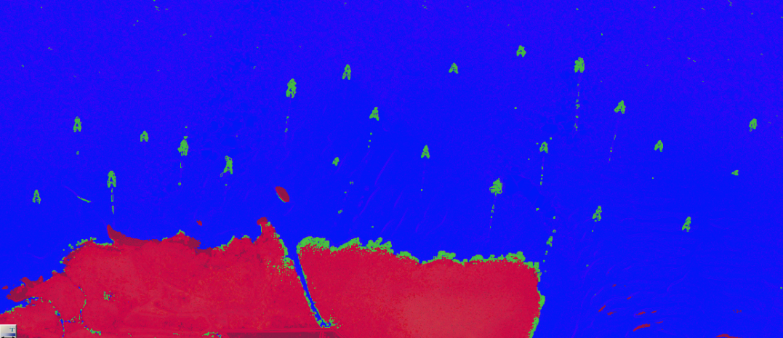
Image Processing
Using ECognition
2
Condition
Water with mean first band of PCA which is greater than or equal to 75 were classified as tall.
11
Notes:
In order to classify the fish corrals after the segmentation, water with mean first band of PCA which is greater than or equal to 75 were classified as tall.

Slide 17
Image Processing
Using ECognition
2
Condition
Cleanup
Classification
After merging, all water objects with relative border to tall objects is equal to one was classified as tall also and was merged.
Water with mean first band of PCA which is greater than or equal to 75 were classified as tall.
The Principal Component Analysis played a great role in the classification of objects.
11
Notes:
Afterwards, some minimal cleanup was done.

Slide 18
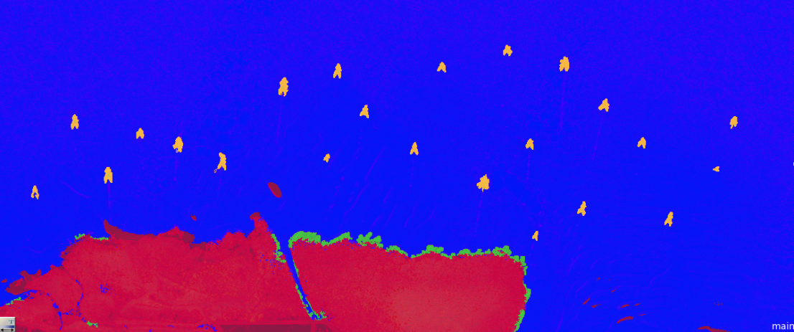
Image Processing
Using ECognition
2
Cleanup
After merging, all water objects with relative border to tall objects is equal to one was classified as tall also and was merged.
11
Notes:
All the tall objects were merged and all the water objects were also merged. All water objects with relative border to tall objects is equal to one was classified as tall also and was merged with the remaining tall objects. All tall objects that are completely surrounded with water were then reclassified as candidates.

Slide 19
Image Processing
Using ECognition
1
2
3
Segmentation
Classification
Contextual Editing
The image was segmented using Multi-threshold segmentation and multi-resolution segmentation
The Principal Component Analysis played a great role in the classification of objects.
Mean DSM | <= 61.45
Mean NR | <= 1.024
Area | =1628
11
Notes:
Then for contextual editing, Candidates with Mean DSM which is less than or equal to 61.45 and mean NR which is less than or equal to 1.024 were reclassified as tall. Furthermore, candidates with number of pixels which is equal to 1,628 was reclassified as tall.

Slide 20
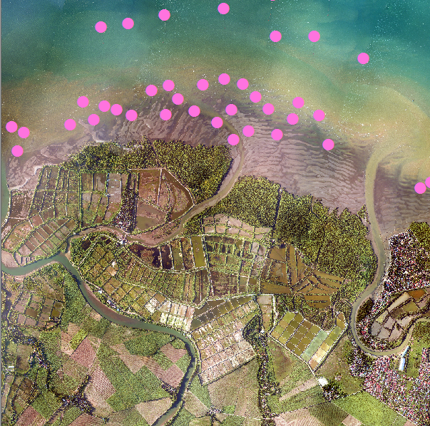
Accuracy Assessment
Accuracy
In order to get a quantifiable accuracy for the map, validation points were made for each individual Fish Corral in the City of Victorias. The accuracy assessment was done manually but ArcMAP was used in selecting the points.
 | Fish Corral | Others | Sum
Fish Corral | 47 | 0 | 47
Others | 0 | 0 | 0
Sum | 47 | 0 | 47
Accuracy | 1
Results
The overall accuracy is 100%. There were 47 validation points and there were also 47 extracted Fish Corrals in the City of Victorias.
12
Notes:
The candidates class were reclassified as fish corrals.
In order to get a quantifiable accuracy for the map, validation points were made for each individual Fish Corral in the City of Victorias. The overall accuracy is 100%. There were 47 validation points and there were also 47 extracted Fish Corrals in the City of Victorias.

Slide 21
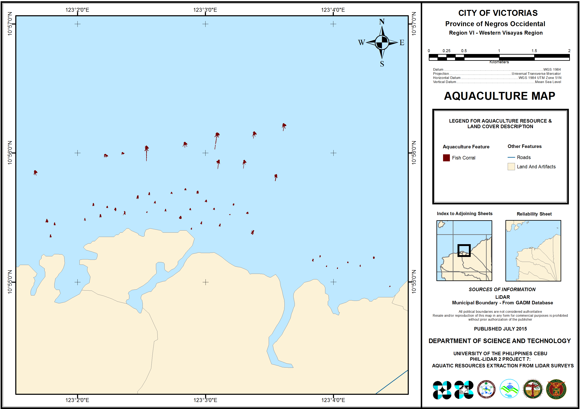
Output Map
Notes:
So we have here the output map for the City of Victorias.

Slide 22
Conclusion
Fish Corral Extraction
The fish corrals in the City of Victorias were extracted using LiDAR data only, with an accuracy of 100%.
14
Notes:
As a conclusion, the fish corrals in the City of Victorias were extracted using LiDAR data only, with an accuracy of 100%.

Slide 23
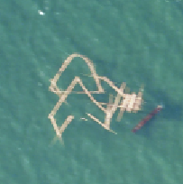
Recommendation
Areas for Improvement
Replication
Unextracted Leader
It might be harder to extract them when it comes to other municipalities or cities that has a more diverse set of aquaculture.
The leader was not fully extracted, only the playground and the bunt were extracted. This might be due to the fact that the leader is basically shorter than the playground or the bunt.
Using Ortho
Future Implications
The extraction of the fish corrals are height-based only which means that submerged fish corrals will not be detected unless the orthographic photo will be added in the workflow
Using the extracted features in the different cities and municipalities, we can learn how to strategically position these fish corrals
15
Notes:
For some areas of improvement,
The extraction of the fish corrals are height-based only which means that submerged fish corrals will not be detected unless the orthographic photo will be added in the workflow.
For replication, it might be harder to extract them when it comes to other municipalities or cities that has a more diverse set of aquaculture.
Then there is the unextracted leader, the leader part of the Fish Corral was not fully extracted, only the playground and the bunt were extracted. This might be due to the fact that the leader is basically shorter than the playground or the bunt itself since the leader only acts as a guide for the fish.
Using the extracted features in the different cities and municipalities, we can learn how to strategically position new fish corrals.

Slide 24




CO-AUTHORS
This study would not have been possible without the following people.
Prof. Judith Silapan
Ariadne Pada
Enzo Campomanes
Julius Garcia
Project Leader
Senior Science Research Specialist
Senior Science Research Specialist
Research Associate
The project leader and at the same time a Doctoral Candidate in the University of the Philippines. She is responsible for bringing LiDAR into UP Cebu.
Currently taking up Master of Science in Environmental Science in the University of the Philippines. Head of Field Validation and Reporting.
Currently taking up Master of Science in Computer Science in the University of the Philippines. Head of Image Processing.
A computer engineer that has also been doing research in Aquaculture Extraction.
16
Notes:
Before I end my presentation, I would just like to thank my team.

Slide 25
THANK YOU!
17
Notes:
Thank you for Listening!

